Slide 1
Web Development for “Java Web Developers”
Web developer
vs.
Java Web Developer

Slide 2
Code Review
by Web Developer

Slide 3

Code Review Oracle Java Developer Conference – nice page ?

Slide 4
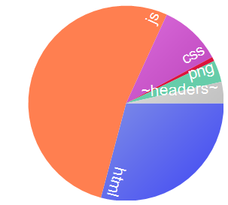
Code Review Oracle Java Developer Conference – resources, network
RESPONSE BYTES (by Content-Type)
--------------
application/js: 227 910
text/html: 126 180
text/css: 44 584
application/png: 15 585
~headers~: 15 380
application/gif: 3 053
Request Count: 44
Bytes Sent: 26 444 (headers:26444; body:0)
Bytes Received: 432 692 (headers:15380; body:417312)

Slide 5
Code Review Oracle Java Developer Conference – various other markers
No DOCTYPE detected ?
BackCompat obsolette compatibility
Deprecated tag FONT
Deepest Nesting Level 45
9 comments found (226 bytes)
Inconsistent class naming conventions, 4 different conventions found
Duplicate IDs on the page
17 inline scripts found (6270 bytes of code is inline in the page)
1 Sensitive Script Accessible Cookies
Server Banner Found
0 lang attributes found
31 images (31/41) without alt found

Slide 6
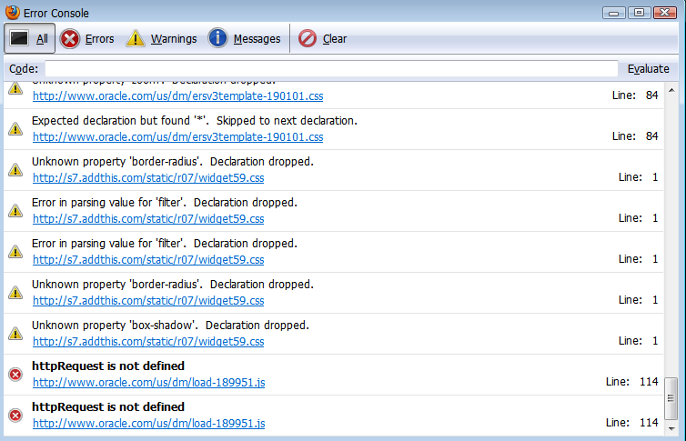
Code Review Oracle Java Developer Conference –JS errors, CSS warnings !

Slide 7
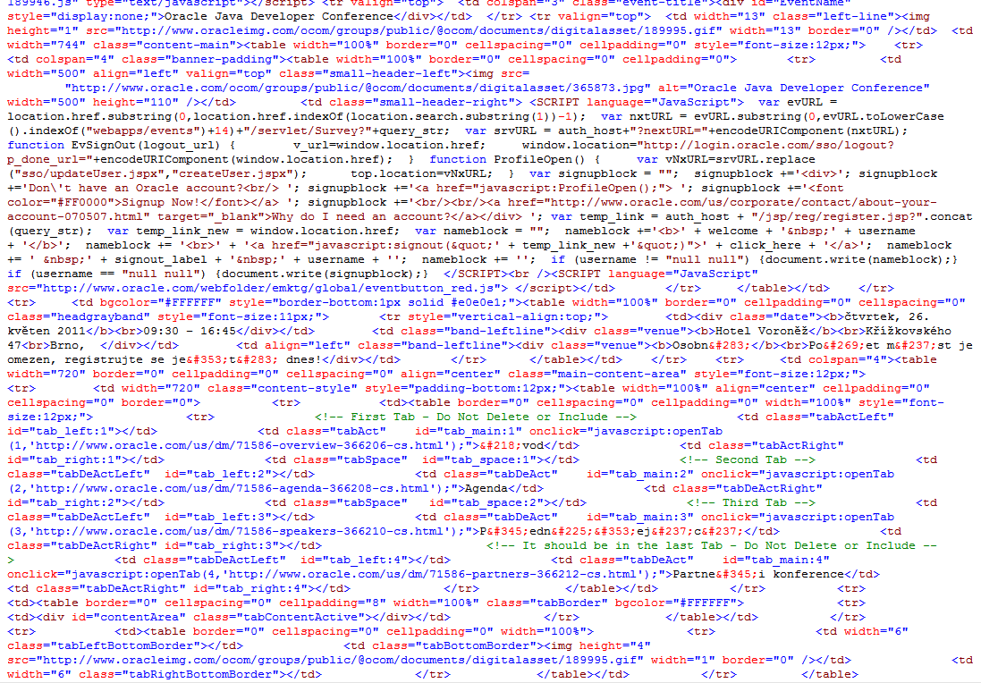
Code Review Oracle Java Developer Conference – random code review

Slide 8
Demo Oracle Java Developer Conference – usability, accessibility
Try to use the web site (to “register for conference”):
Without mouse
With CSS disabled
With JavaScript disabled
With small screen
With slow network

Slide 9
Big Sites very raw statistics
Mix from MS, Oracle, IBM, Apple
Size calculated from serialized DOM is: 139406
Deepest Nesting Level 24
63% of elements (1074/1726) has css class specified (29385 bytes overhead)
24% of elements (240/1025) has ID specified (4710 bytes overhead)
39% of elements (666/1726) are DIVs and SPANs (10392 bytes overhead)
61 images (61/73) without alt found
174 comments found (4167 bytes)
Duplicate IDs on the page
36% of elements (595/1665) has Inline Event Handler (40072 bytes overhead)
16 inline scripts found (12969 bytes of code is inline in the page)
Lot of info ? NO just bad markup !
Really bad markup, crashes VS 2010 ;-)
Learn some CSS please !
So many scriptable elements? id based CSS?
Better than tables, try also old <P>
Content or decoration ? CSS background ?
Thanx for waste and hacking hints
Super-long ids and still have duplicates ?
DHTML Lower or bad components ?
12K of code unique per page/request ?

Slide 10
Reasons ? Personal view
Thinking
Knowledge
Development Style

Slide 11
Reasons ? Personal view
Poor quality Java Frameworks from Web perspective
Bloated markup
Tag usage just for presentation, semantics missing
Obtrusive, ad-hoc JavaScript, too tight markup + code integration
Overuse of inline styles and inline handlers
Overuse of CSS classes and IDs
Even not well formed or in valid HTML

Slide 12
Reasons ? deeper look
Java “Web Developer”
Develop Application for Web
Web Developer
Develop Web Application
Components, Abstractions, OO
Generated client scripts, server side “ajaxified” components
Inline Styles (by CMS), customization, presentation class names
Everything is POST
Defaults: 200, 500, 404
Generated links, single URI APPs
What ? Oh, lets make text version
Build another mobile version
By more servers and bandwidth
Code = Java, Templates, Libraries
Semantic HTML Markup
Unobtrusive JavaScript, client side XB libraries
Progressive Enhancement with CSS, semantic CSS class names, markup independence
HTTP Method Semantics
HTTP Error Codes
URI design and semantics
Design for Accessibility
Responsive Design
Page Load Performance
Code: HTML, CSS, JS, HTTP

Slide 13
Solutions ?
Better “High Abstraction Frameworks” and use same old Java developers
Better “Low Level Libraries” and educate Java developers in WEB
Split Java and Web tasks
???
Personal Notes:Start with B and build A over good B with educated Java+Web developers, reuse Web knowledge on other platforms as well. Option C is hardly feasible even in orthodox MVC approach

Slide 14
My personal vote: Solution B) Better Low Level Libraries
Write HTML in HTML (don’t start with high level abstractions)
Benefit from new HTML5 semantics and simplifications
Don’t force any, allow many styles
JSP, JSPX, Servlet, JSTL, Custom Tags, Tiles, Struts, Spring MVC
Pure Java code
Any other based on the above

Slide 15
Solution B) Better Low Level Libraries
Start with Basics = Start with Markup
HTML Markup
Language of Web
Language of Browsers
and
Language of Machines

Slide 16
HTML Markup
Our
HTML5
TagLib
+
DSL
One
Web
Mission
(Dream?)
JSP Page, .jsp
Free Syntax
HTML 4
SGML Syntax
Text/html
Legacy
Browsers
XML Machines
JSPX Page, .jspx
XML Syntax
XHTML 1.0, 1.1
XML Syntax
application/xhtml+xml
MSIE 7,8
Ajax, XML (+XSLT)
XHTML 1.0, 1.1
XML Syntax + Comp.
text/html
Ajax, DOM+CSS Sel.
HTML5
HTML Syntax
Common
Browsers
Ajax, DOM+CSS Sel.
HTML5
XML Syntax
MSIE 9
Code
Streams, Builders, Components
Edge
Browsers
HTML5
XML Syntax+Comp.
Notes:
HTML + Browsers appeared
And of course worked together
JSP has been invented
to generate HTML from Java
At that time we also had Code (Servlets, CGI)
to generate HTML, usually using streams or simple builders
XML became popular and XML Machines greedy to parse HTML appeared,
they could but with troubles
So they have invented XHTML and JSPX
XML Machines could be happy
And good browsers used XML syntax for stricter parsing and error reporting
But Evil MSIE
Did not support XHTML content-type
Luckily there has been an option called Compatibility Guideline (Appendix of XHTML) which allows to send XML syntax over text/html. We call this XHTML/HTML (read XHTML over HTML content-type).
This is understood by MSIE. But your tags MUST follow certain rules. If the don’t, MSIE
as well as common browsers will display blank page, do not download script or create invalid DOM. Also Strict error handling is OFF in this case.
To generate XML or XML+Comp from JSP is easy, requires only discipline. Stricter syntax of XML+Comp renders lax, full XML syntax useless.
MS Client Side Developers could benefit from XML syntax, because MS Browser supported well XML, XSLT development (with XHR+MSXML default parser),
just content type was (is) wrong (text/xml required)
Then JSPX. I don’t get the reason to have XML strict markup on server. Maybe to generate and manupulate source code but it brought more trouble then benefit in this context.
While it is easy to generate XHTML
It is almost impossible to generate HTML from XML syntax (text tricks needed)
And to generate XHTML+Comp. it requires tricks (even with Cross Container differencies).
Looking at this, the Code is still immune to big troubles, and difficulties exists only in duplicated code for each markup.
While MSIE invested mostly into XML, others invested into CSS selectors and native DOM manipulations.
The Ajax Stack actually started to prefer HTML or XHTML/HTML format. But worked well with all 3.
While MSIE failed miserably with direct XML syntax insertion into HTML dom.
Then: HTML5, 2+1 syntaxes ?
Technology Edge browsers
And MSIE 9,
Should not have any trouble with all syntaxes
XML machines can consume HTML5 XML Syntax
To generate HTML 5 from JSP , JSPX and CODE the same applies. JSP and code, OK but duplicit code.
From JSPX, HTML almost impossible
XML syntax OK
XML+Compat. Possible but quirks
Now usability of HTML 5 in older browsers: MSIE 8 and XML Syntax : impossible
HTML Syntax with new tags, possible only with client side JS polyfil (html5shim)
Same
This is almost complete mess (could be simplified, many are duplicit) but there are 3 basic outcomes:
To make everyone happy, you must produce multiple representations (markup syntax+content-type) and have redundant code.
HTML syntax OK (only XML machines complain)
XML syntax without Comp. is redundant, use XML+Comp. always
JSPX is harmful
Almost Fixed, hard to change decision about server markup, client markup, content type
Redundant and quirky code

